Slide 1

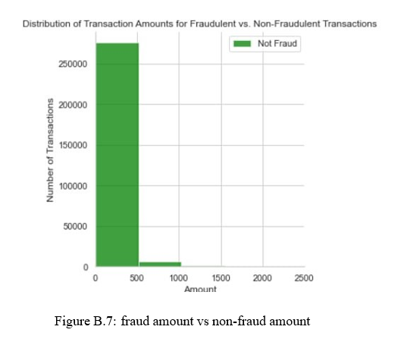
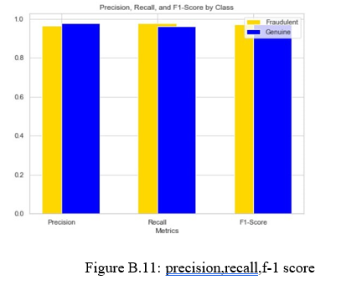
Koneru Lakshmaiah Education Foundation, Hyderabad(Aziz Nagar,Off Campus)
CREDIT CARD FRAUD DETECTION
V.Abhiram, R.Vivek Vardhan Reddy, A.Shiva Raghavendra, MVS Saiteja
Department of Computer Science and Engineering, Koneru Lakshmaiah Education Foundation, Hyderabad-500075, Telangana, India.
Abstract
Methods and Materials
Discussion
With the growth of e-commerce websites, to carry out transactions that have led to an exponential increase in the usage of credit cards . ’Fraud’ in credit card transactions is unauthorized and unwanted usage of an account by someone other than owner of account . Fraudulent credit card transactions lead to a loss of huge amount of money . Objective this project to predict the fraud and fraud less transaction with respect to time and amount using machine learning algorithms . The system prevents fraudulent users from misusing the details of the credit-card of the genuine users for their personal gain . The spending habits of the credit-card owner is used to detect the fraud.
Credit card fraud detection is a critical area of focus for financial institutions and businesses to protect both themselves and their customers from fraudulent transactions. Several tools and technologies are employed to detect and prevent credit card fraud:
Machine Learning and AI: Machine Learning Algorithms: Various machine learning models, such as logistic regression, decision trees, random forests, and neural networks, are used to analyse trans- action data and identify patterns associated with fraud. Data Analytics: Descriptive Analytics: These tools help in understanding historical transaction data and identifying unusual patterns. Predictive Analytics: Predictive modelling and statistical analysis are used to anticipate potential fraud based on historical data. Data Mining: Data mining techniques are used to extract valuable insights from large datasets, helping in the identification of fraud patterns. Fraud Detection Software: There are numerous commercial and open-source fraud detection software solutions such as FICO Falcon, Actimize, etc…
We compared the performances of random forests and genetic algorithm individually and also combined approach of genetic algorithm and random forest when compare with single accuracy results the combined approach got accuracy. In this we took dataset from Kaggle and I divided the data set into training and testing dataset with the help of genetic algorithm and later with the random forest we performed the operators. Finally, mutation got the highest value with the fitness function, got the good performance. In future I want to implement a software with high security and costumers can pay their money whenever they want with the help of eye recognition and fingerprint.
Introduction
Results
Conclusions
Traditionally, rule-based methods were used to detect credit card fraud. These algorithms would search for particular patterns in transaction data, such as a high number of transactions from a single place in a short amount of time, that were suggestive of fraud.
Machine learning has emerged as the go-to method for detecting credit card fraud in recent years. After being trained, these models may be used to instantly assess new transactions and determine which ones are probably fraudulent. Credit card fraud detection projects typically involve the following steps:
i. Data Collection ii. Data Preparation iii. Model Selection iv. Model Training v. Model Evaluation vi. Model Deployment
Testing is a process of executing a program with intent of finding an error. Testing presents an interesting anomaly for the software engineering. The goal of the software testing is to convince system developer and customers that the software is good enough for operational use. Testing is a process intended to build confidence in the software. Testing is a set of activities that can be planned and conducted systematically. Software testing is often referred to as verification and validation.
For Input 1: Here 1 model is predicted genuine transaction as fraud . This implies it allows client to investigate further about the transaction to confirm its nature to avoid losses . For Input 2: Here fraud transaction shows output as fraud . So our model is predicting best results . For Input 3: Her all the models predicted that transaction is genuine . So there is no need to doubt the transaction . Finally , Out of three models Decision Tree Model is best .
This paper emphasizes the significance of technological advancements and the widespread availability of online shopping. Credit card payment emerges as a popular mode of transaction in this digital era, with a substantial number of credit card users worldwide. However, the increasing prevalence of fraudulent credit card transactions poses challenges for both banks and customers, resulting in financial losses. To address these issues, the paper underscores the importance of implementing a secure credit card fraud detection system. It explores the application of various machine learning algorithms, including Naive Bayes, Logistic Regression, SVM, Decision Trees, Random Forest, Genetic Algorithm, J48, and AdaBoost, for credit card fraud detection.
Future Directions
As we took dataset from Kaggle and divided the data set into training and testing dataset with the help of genetic algorithm and later with the random forest we performed the operators. Finally, mutation got the highest value with the fitness function, got the good performance. In future we want to implement a software with high security so that costumers can pay their money whenever they want with the help of eye recognition and fingerprint.
Contact Information
References
Acknowledgements
Rokkam vivek vardhan reddy
Abhiram v
Raghavendra goud
Mvs sai teja
Credit Card Fraud Detection using Machine Learning and Data Science by S P Maniraj, Aditya Saini, Swarna Deep Sarkar and Shadab Ahmed. IJERT ISSN: 2278-0181 Vol. 8 Issue 09, September-2019.
Credit Card Fraud Detection With Machine Learning in Python by Nikhil Adithyan, 2020. CodeX - ac7281991d87
Credit Card Fraud Detection Dataset version 3 provided by Machine Learning Group – ULB on Kaggle in 2016 (last updated on 2018).
Iwasokun GB, Omomule TG, Akinyede RO. Encryption and tokenization-based system for credit card information security. Int J Cyber Sec Digital Forensics. 2018;7(3):283–93.
We would like to thank the following people for their support and guidance without whom the completion of this project in fruition would not be possible.
Mrs. P. Sree Lakshmi, our project guide, helped us and guiding us in the course of this project.
Dr. Arpita Gupta, the Head of the Department, COMPUTER SCIENCE AND ENGI- NEERING.
Our internal reviewers, Dr. Sumit Hazra, Mrs. P. Sree Lakshmi,
Dr. SR. Mugun than for their insight and advice provided during the review sessions.

